Slide 1
EITK presentation on United Nations Conference on Trade and development
By Group 6: Shubham
Siddharth
Vasav
Romil
Shreyash
Likhit

Slide 2

Introduction
UNCTAD is the part of the United Nations Secretariat which deals with trade, investment and development issues.
It was established in the year 1964 with over 194 Countries as members.
It’s main is tom “maximize the trade, investment and development opportunities of developing countries and assist them in their efforts to integrate into the world economy on an equitable basis.”
It’s headquarters are in Geneva, Switzerland and have offices in New York and Addis Ababa.

Slide 3
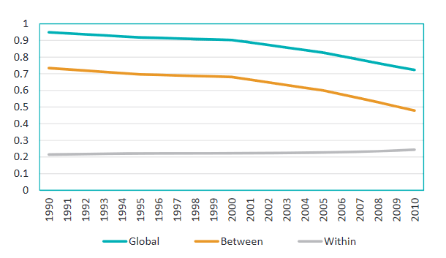
Objectives and Functions:
To reduce and eventually eliminate the trade gap between developed and developing countries.

Slide 4
It functions as a forum for intergovernmental deliberation.
It undertakes research, policy analysis and data collection for the debates of government representatives and experts.
To be available as a center for harmonious trade and related documents in the development policies of governments.

Slide 5
Main Activities:
Trade and Commodities
Investment, Technology and Enterprise Development.
Macroeconomics Policies, Debt and Development Financing.
Transport, Customs and Information Technology.
Special programme for least developed, landlocked developing and small island developing countries.

Slide 6
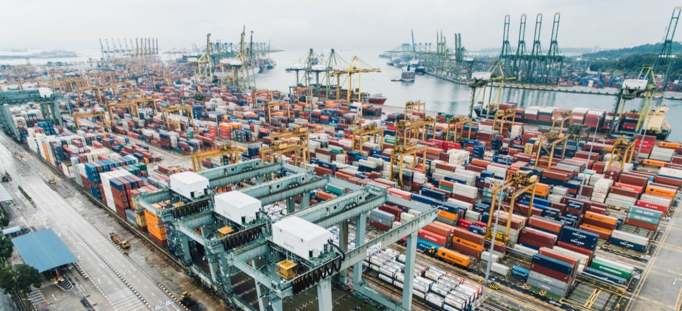
Trade and commodities
Promotion of commodities that is grown by traditional knowledge of farming.
Undertake programme involving scientists and farmers to restore the barren lands using traditional farming techniques and native seeds.
Protection of those farming lands where the farmers have been cultivating for thousands of years.
Conservation and promotion of indigenous crops grown in various region.

Slide 7
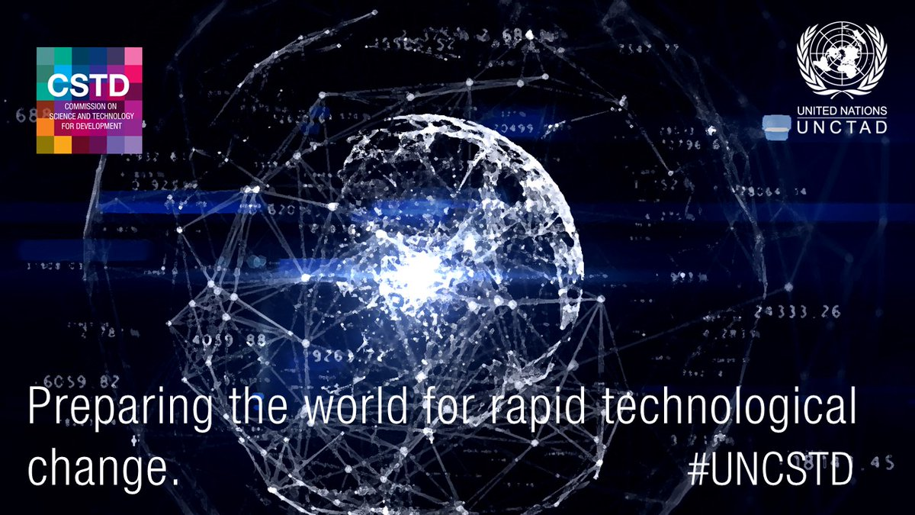
Investment, Technology and Enterprise development
Encourage investment in the traditional knowledge that will be effective in combating climate change.
Promotion of traditional scientific knowledge from different countries around the globe for betterment of human life.
Promotion of small entrepreneurs who are involved in using their traditional knowledge or skill set in making scriptures and other such things.

Slide 8
Macroeconomics Policies, Debt and Development Financing.
In Formulating policy analysis and research on issues concerning global economic interdependence, the international monetary and financial system, and macroeconomic and development policy challenges.
In Providing technical and advisory support.
Providing computer-based debt management and financial analysis system specially designed to help countries manage their external debt.

Slide 9
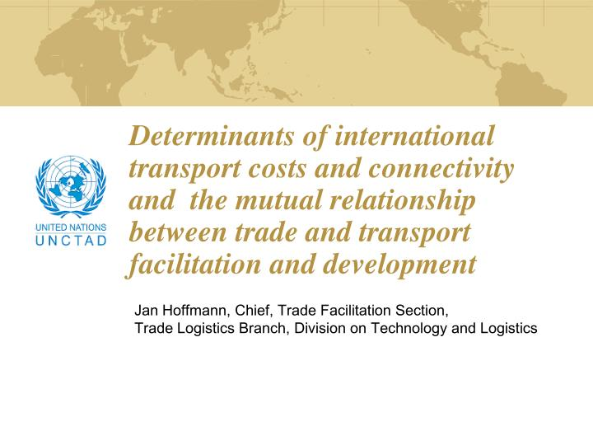
Transport, Customs and Information Technology.
Integrated customs system that speed up customs clearance procedures and helps governments tomreform and modernize their customs procedures and management.
Computerized cargo tracking system installed in 20 developing countries of Africa and Asia.
Building Training networks and organizes training in all areas of international trade to enable developing countries to increase their competitiveness.

Slide 10
Promoting innovation of traditional knowledge
UNCTAD promotes strengthening to the capacity of individuals and local communities to develop Traditional knowledge in natural product-based industries that support long-term sustainable economic development and help to protect their Traditional knowledge.
Central and local governments also help UNCTAD to enhance innovation by creating special supportive mechanisms for individual and local communities.
The Government of India has set up a national innovation foundation with initial funding of US$ 5 million which intended to build national registers, mobilize IPRs for TK innovations.

Slide 11
Commercialization traditional knowledge:-
Commercialization of TK-based products and services may provide opportunities.
We should be recognized that certain indigenous communities prefer to focus on cultural and spiritual values.
Also we should be noted that there are limitations for the commercialization of TK.
The commercialization of TK-based products and services is rising due to commercial interest in biodegradable products and other shifts in consumer behaviour in developed and developing countries.

Slide 12
Examples:- Art and handicrafts:
Traditional artworks are sometimes mass-produced for tourists as generic traditional works and sold through the TK memorial trade.
Usually It doesn't breach copyright.
Also this arts are produced by traditional community artists.
This arts are specifically for art collectors to generate significant revenues .

Slide 13
Traditional medicines:
Part of the US$ 60 billion world herbal medicine market is based on TK.
Because of that it provides trading opportunities for developing countries, To taking such opportunities may require appropriate legislation, quality control and marketing.
Example:- India’s exports of medicinal plants and herbal products are about US$ 8 million annually, due to this India is entering world markets for herbal products in a significant way.
It included food supplements, aromatic oils, cosmetics and body care products.

Slide 14
Native species:
Indigenous peoples across Australia use some 10,000 native plant species for food.
The principal value of various bushfoods is an ingredients (flavors , species, condiments) in preparation of other foods.
The industry’s real potential, based on the ‘organic-ness’ of its products, lies in overseas markets.
Indigenous communities may need to examine appropriate forms of intellectual property protection to capitalize on their TK in the market place without jeopardizing the very values that sustain it.

